Slide 1
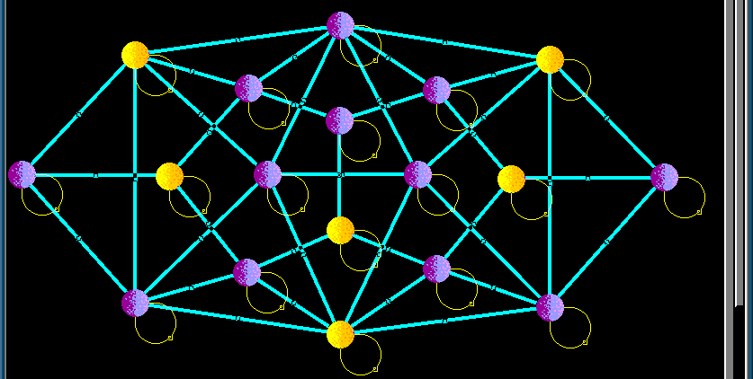
Tutorial 9
﻿CS5486 Intelligent Systems:
Simulated Annealing and
Boltzmann Machine
Hongzong Li
Department of Computer Science City University of Hong Kong

Slide 2
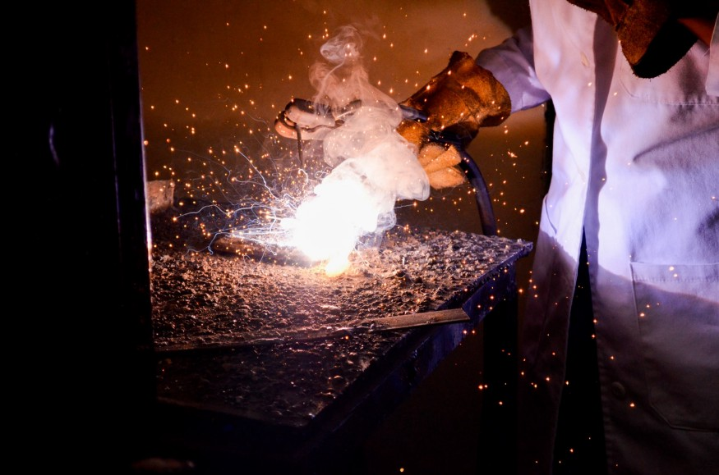
Simulated Annealing
It’s inspired by the annealing process in metallurgy, where materials are heated and slowly cooled to achieve a stable structure with minimal energy.
What is Physical Annealing?
When the material is hot, the molecular structure is weaker and is more susceptible to change.
Notes:
The Simulated Annealing algorithm is based upon Physical Annealing in real life. Physical Annealing is the process of heating up a material until it reaches an annealing temperature and then it will be cooled down slowly in order to change the material to a desired structure. When the material is hot, the molecular structure is weaker and is more susceptible to change. When the material cools down, the molecular structure is harder and is less susceptible to change.

Slide 3

Simulated Annealing
Another important part of this analogy is the following equation from Thermal Dynamics:
Notes:
temperature t along with the Boltzmann constant k.

Slide 4
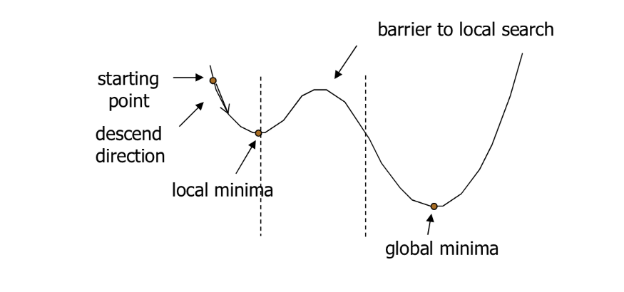
Simulated Annealing
Simulated Annealing (SA) mimics the Physical Annealing process but is used for optimizing parameters in a model. This process is very useful for situations where there are a lot of local minima such that algorithms like Gradient Descent would be stuck at.
Notes:
SA is capable of finding a global maximum and not stuck at local minima.

Slide 5
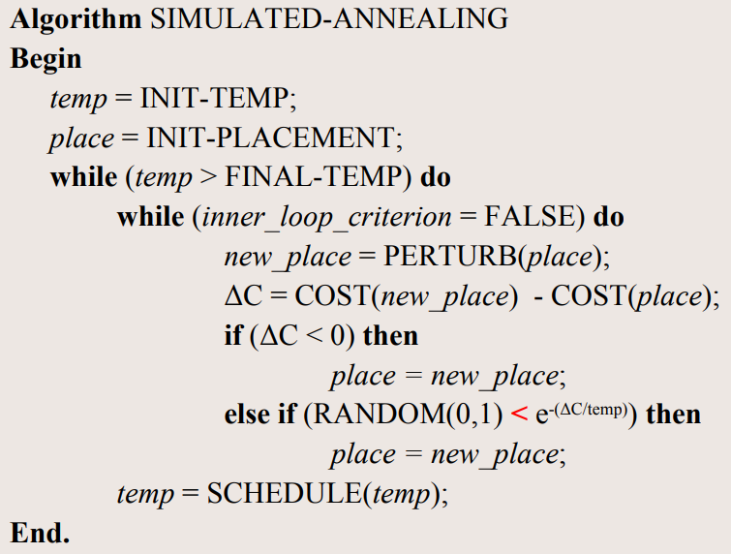
Simulated Annealing
Algorithm

Slide 6
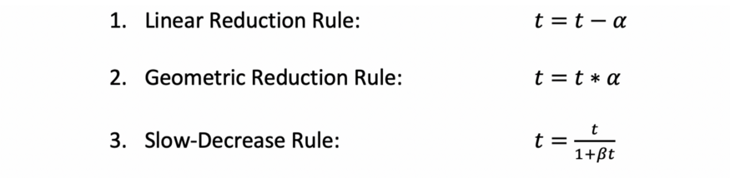
Simulated Annealing
Algorithm
Each reduction rule reduces the temperature at a different rate and each method is better at optimizing a different type of model. For the 3rd rule, beta is an arbitrary constant.

Slide 7
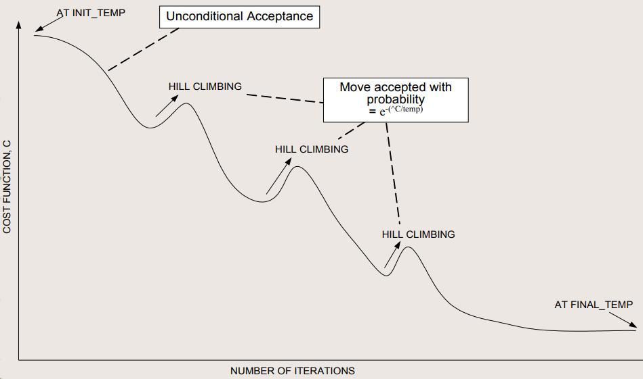
Simulated Annealing

Slide 8
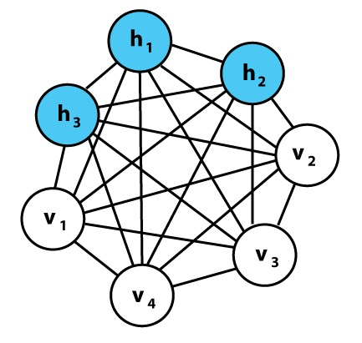
Boltzmann Machine
A Boltzmann Machine (BM) is a type of stochastic recurrent neural network. It is inspired by statistical mechanics and is useful for learning probabilistic distributions over binary vectors.
Structure of a Boltzmann Machine
1. Nodes (Neurons):
Each node is a binary unit (either 0 or 1).
Two types: visible units (input) and hidden units (learn features).
2. Connections:
Every unit is connected to every other unit except to itself.
No directionality – it's an undirected graph.
Hinton, G.E. (2002). Training products of experts by minimizing contrastive divergence.

Slide 9
Boltzmann Machine
The network assigns an energy to each possible state (configuration of nodes), defined as:
Energy-Based Model
weights between visible-visible and hidden-hidden units (only in full BM)

Slide 10
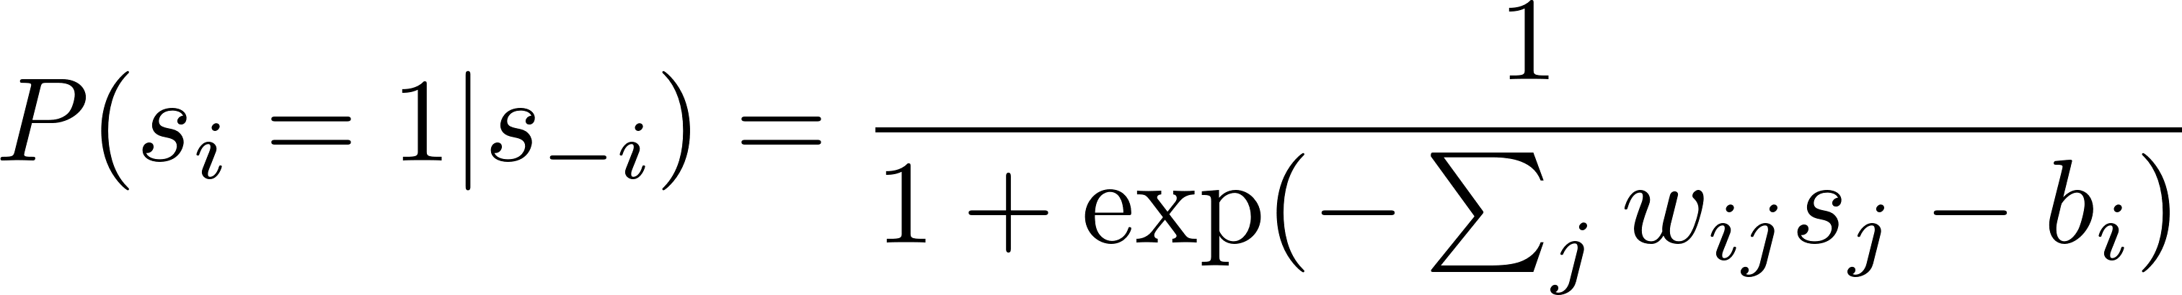
Boltzmann Machine
Sampling via Gibbs Sampling
Gibbs Sampling lets us sample from the joint distribution of the BM.
Fix all nodes except one.
Update one node at a time using its conditional probability:
Update unit i
Sigmoid activation

Slide 11
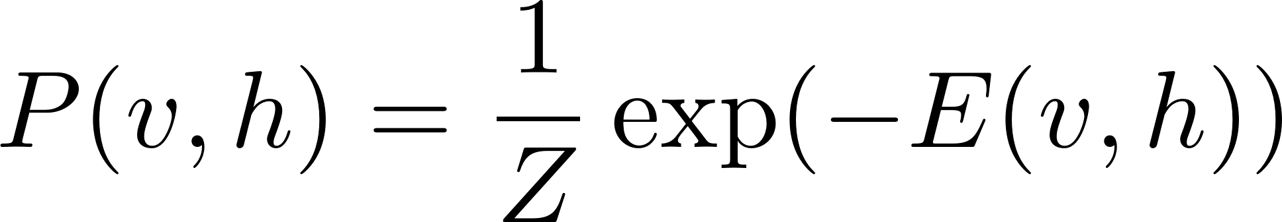
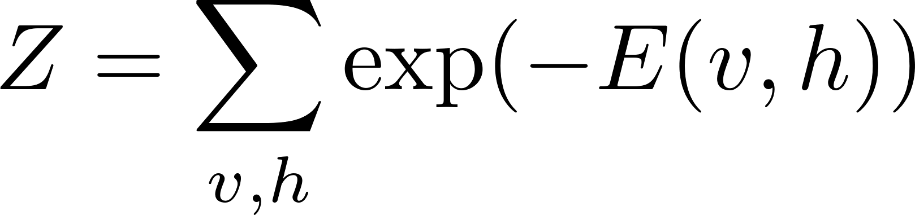
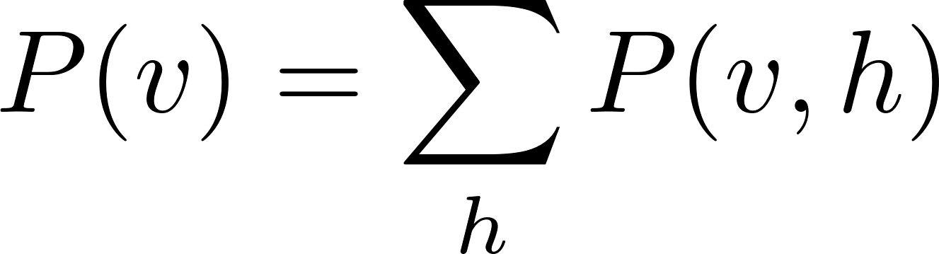
Boltzmann Machine
A Boltzmann Machine defines a joint probability over visible and hidden units:
The probability of visible vector

Slide 12
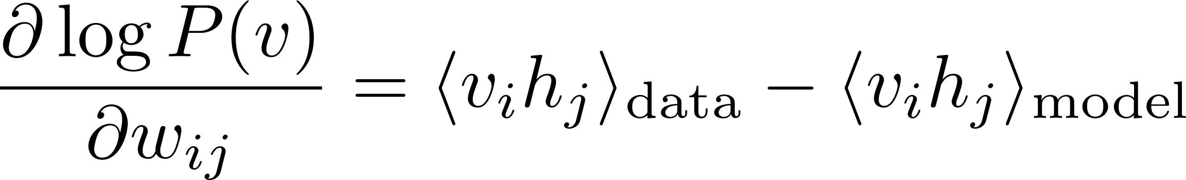
Boltzmann Machine
Maximize likelihood P(v) of the training data → minimize energy of real data
Positive phase: strengthen connections based on real data
Negative phase: weaken connections based on samples from the model

Slide 13
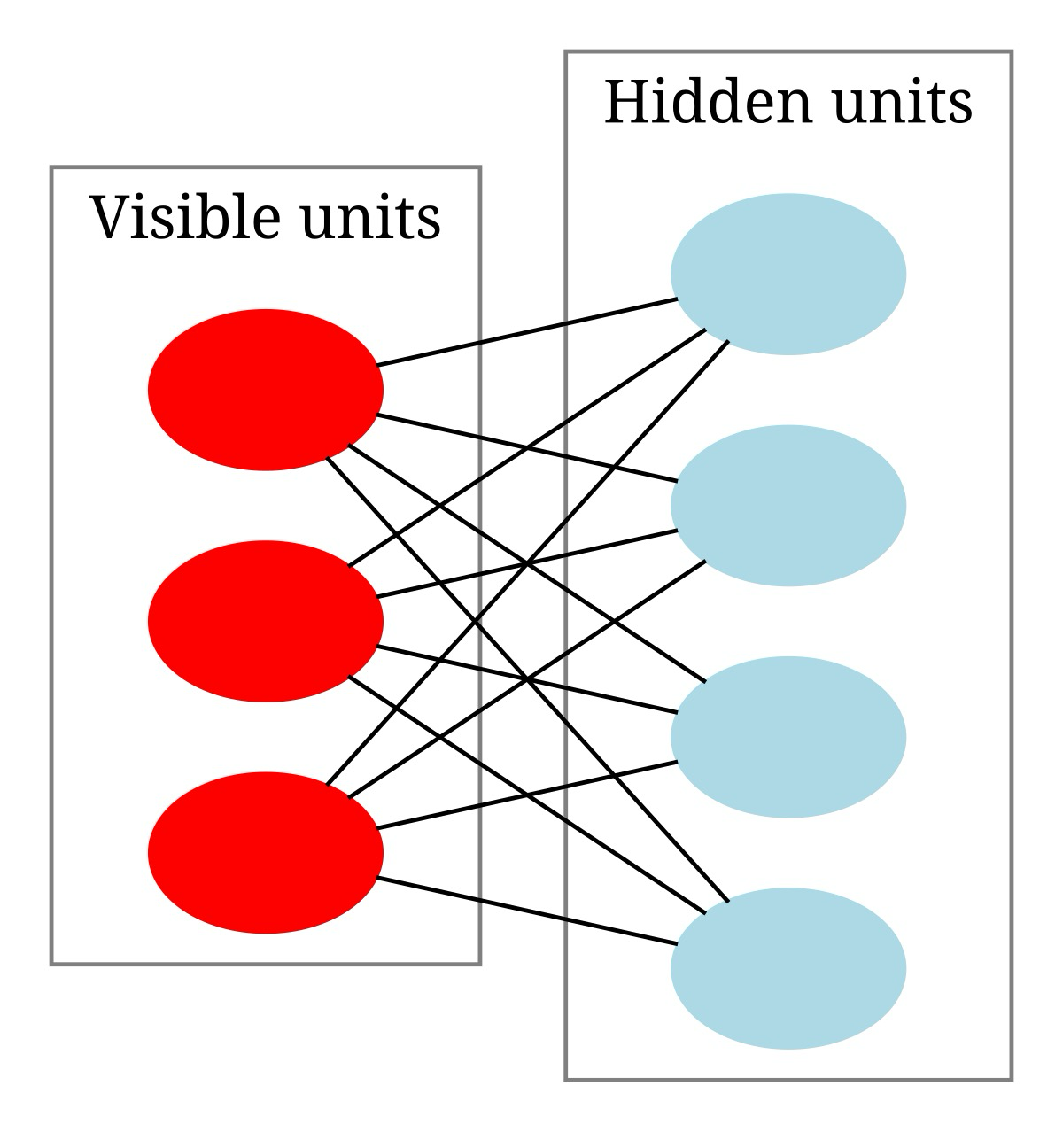
Boltzmann Machine
Restricted Boltzmann Machine
BM is powerful, but slow and hard to train. So we use a simplified version: RBM.
No connections between units within the same layer.
Only visible-to-hidden connections.

Slide 14
Thanks

